Slide 1

Real-Time Emotion Recognition and Emoji Integration
Team Members:
V.Srinath
T.Kinshuk

Slide 2

Agenda
Motivation and Background
Datasets worked on
Preprocessing methods
Flow diagram
Objectives
Novelty
Implementation
Confusion matrix
Results
UI
Timeline
References

Slide 3

Motivation and Background
While video chats have become commonplace, the lack of facial expressions and body language can make effective emotional communication difficult. This project intends to bridge the communication gap by developing a system for real-time voice emotion identification, which will generate real-time visual representations (emojis) that dynamically reflect the speaker's emotions by analyzing emotional clues within spoken words.

Slide 4
Objectives
Speech Emotion Recognition
Emoji Integration
Real-time speech Integration with emojis

Slide 5

Novelty
The novelty in our project lies in combining speech emotion recognition with real-time emoji-based reactions in video chats. This has the potential to improve user experiences and provide a new layer of communication to video calls.

Slide 6

Datasets worked on
The Ryerson Audio-Visual Database of Emotional Speech and Song (RAVDESS)
Audio speech Actors – 24 actors files each actor consists 60 recordings. Total=1440 files
Audio song Actors – 24 actors files each actor consists 44 recordings.
Total=1056 files

Slide 7
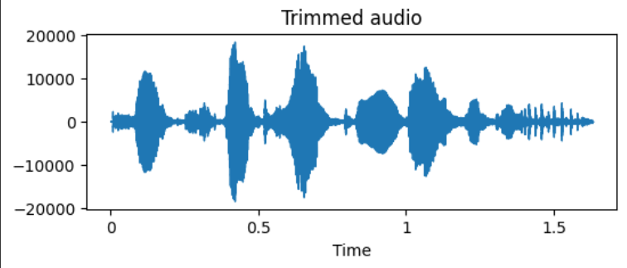
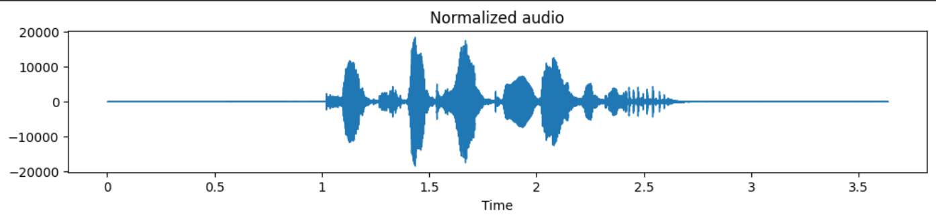
Preprocessing Methods

Slide 8
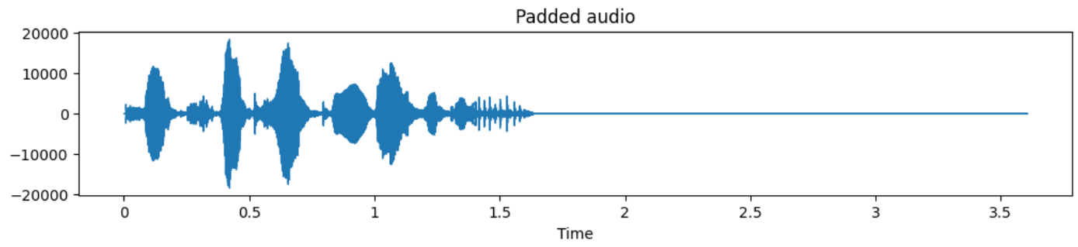
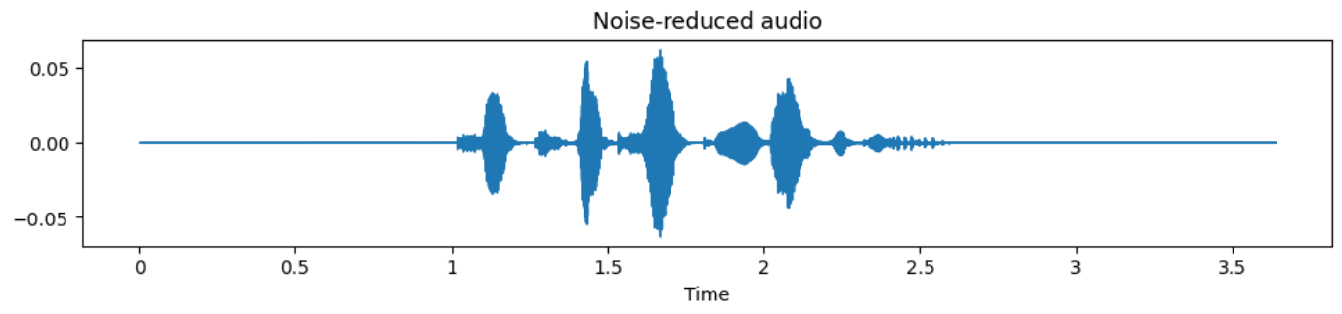

Slide 9
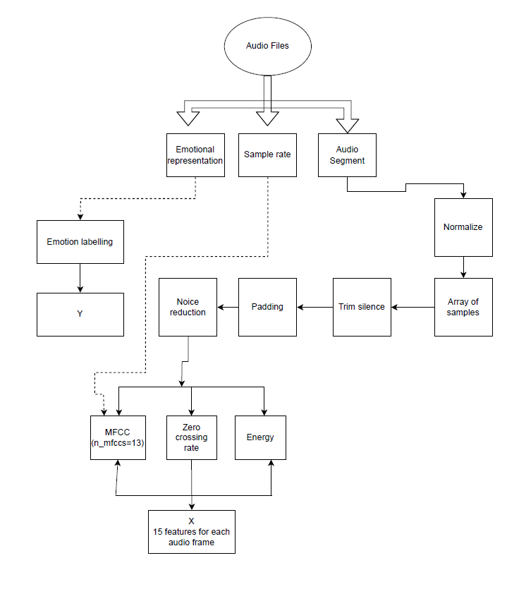
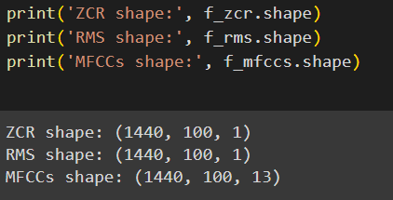

Slide 10
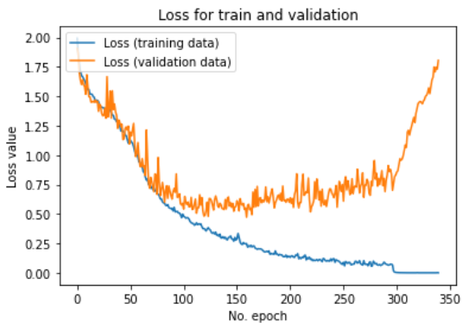
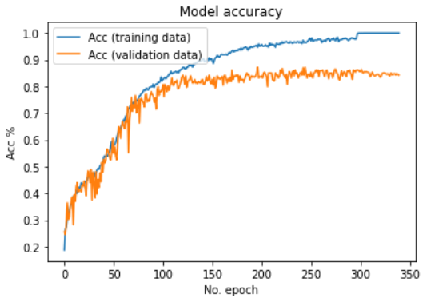
Implementations

Slide 11
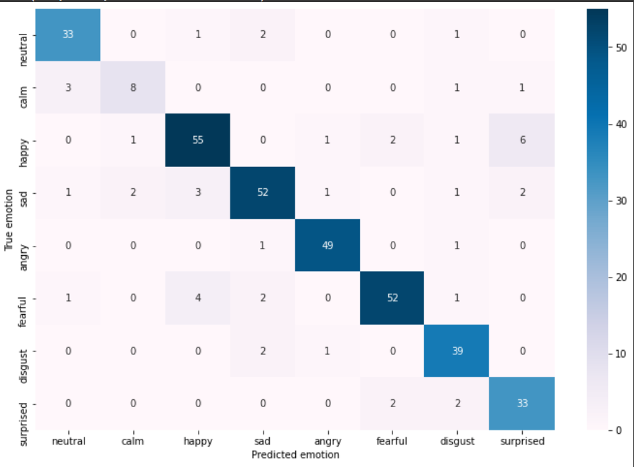
confusion matrix

Slide 12
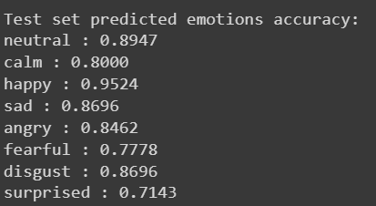
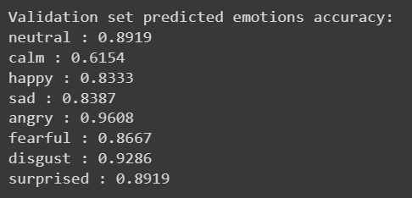
Results

Slide 13
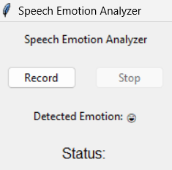
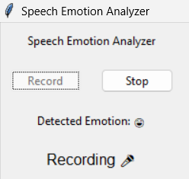
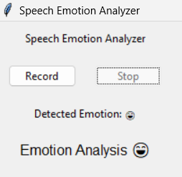
UI

Slide 14
Task Description | Srinath | Kinshuk
Project Planning | 1 week | 1 week
Literature Review | 1 week | 1 week
Dataset Acquisition and Preparation | 2 weeks | 2 weeks
Technical Development
Feature Extraction Implementation | 1 week
Emotion Recognition Model Development |  | 2 weeks
Real-Time Audio Processing Implementation | 2 weeks
Emotion-to-Emoji Mapping System Development | 2 weeks
Integration |  | 2 weeks
User Interface Design and Implementation | 2 weeks
Testing and Validation
System Testing and Debugging | 2 weeks | 2 weeks
Timeline

Slide 15
Reference
[1] J. Ye, X. -C. Wen, Y. Wei, Y. Xu, K. Liu and H. Shan, "Temporal Modeling Matters: A Novel Temporal Emotional Modeling Approach for Speech Emotion Recognition," ICASSP 2023 - 2023 IEEE International Conference on Acoustics, Speech and Signal Processing (ICASSP), Rhodes Island, Greece, 2023, pp. 1-5, doi: 10.1109/ICASSP49357.2023.10096370.
[2] A. Iqbal and K. Barua, "A Real-time Emotion Recognition from Speech using Gradient Boosting," 2019 International Conference on Electrical, Computer and Communication Engineering (ECCE), Cox'sBazar, Bangladesh, 2019, pp. 1-5, doi: 10.1109/ECACE.2019.8679271.
[3] https://zenodo.org/records/1188976#.X4sE0tDXKUl -Dataset

